Slide 1
Computer Vision Project «Image Style Transfer»
Prepared by: Solnyshkina Kseniya
Moscow, 2025

Slide 2
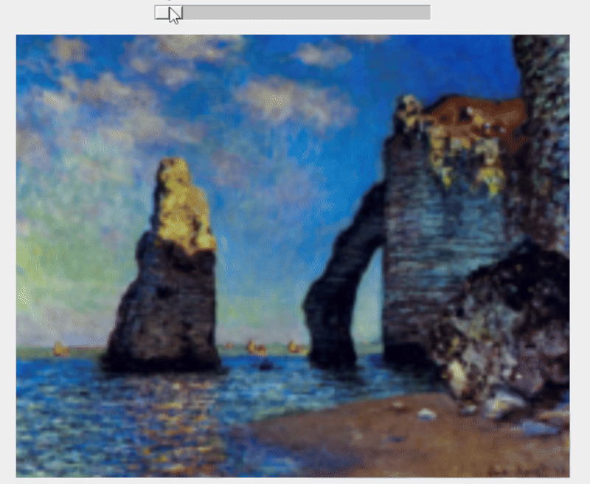
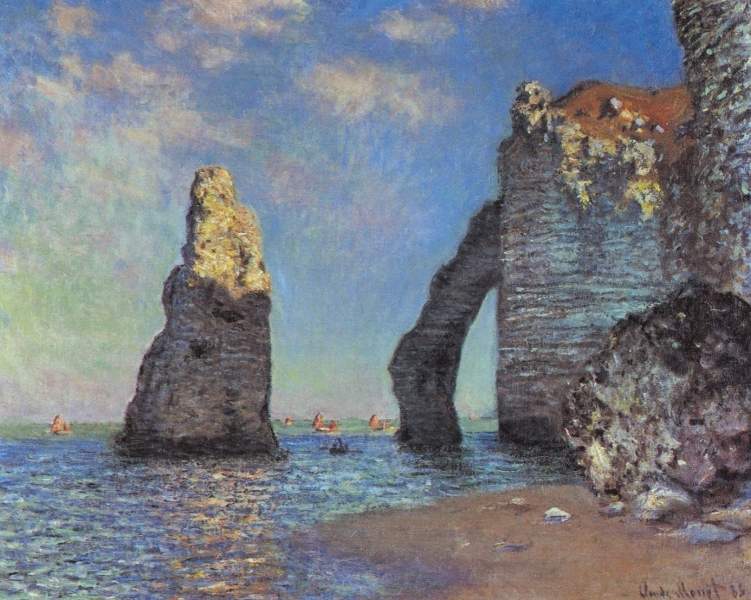

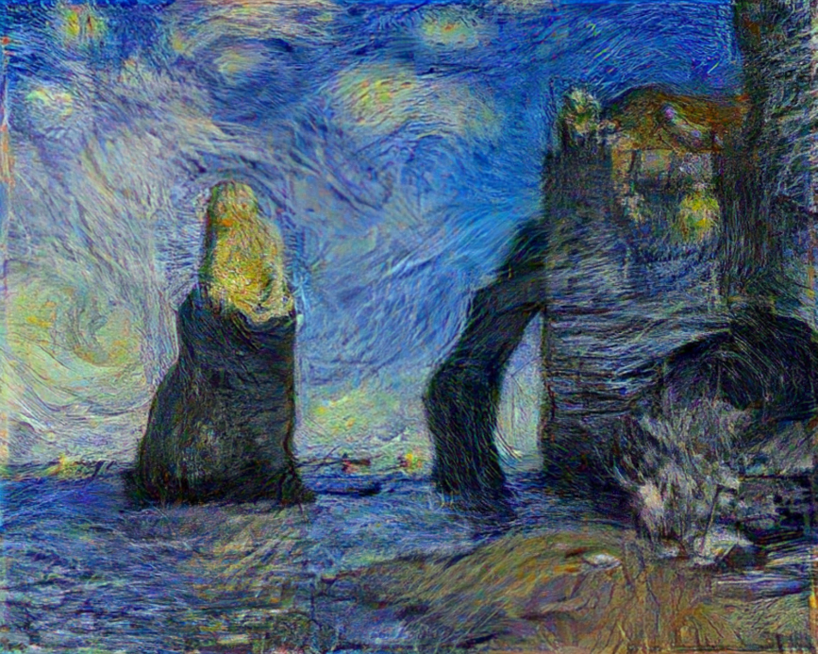
Style Transfer

Slide 3
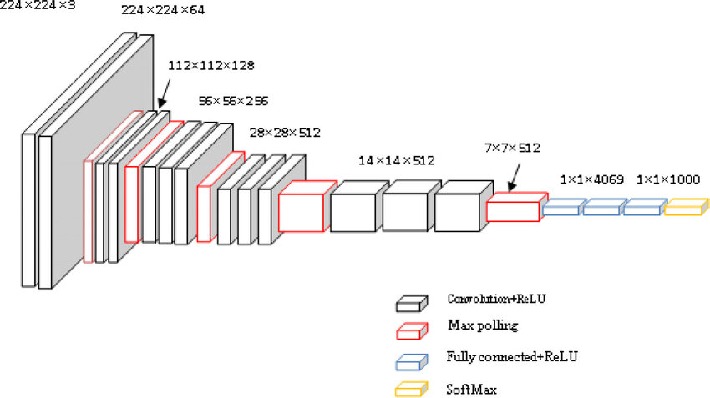
VGG-19

Slide 4
Content and Style Losses
Content Loss
Style Loss
MSE(input map – original map)
Style Loss
Style Loss
Style Loss
MSE(G(input map) – G(original map))
G – Gram matrix
Style Loss
Style Loss
Content Loss

Slide 5
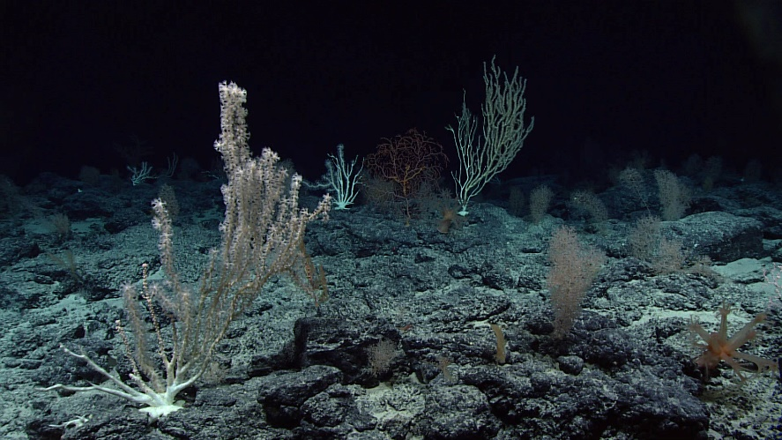

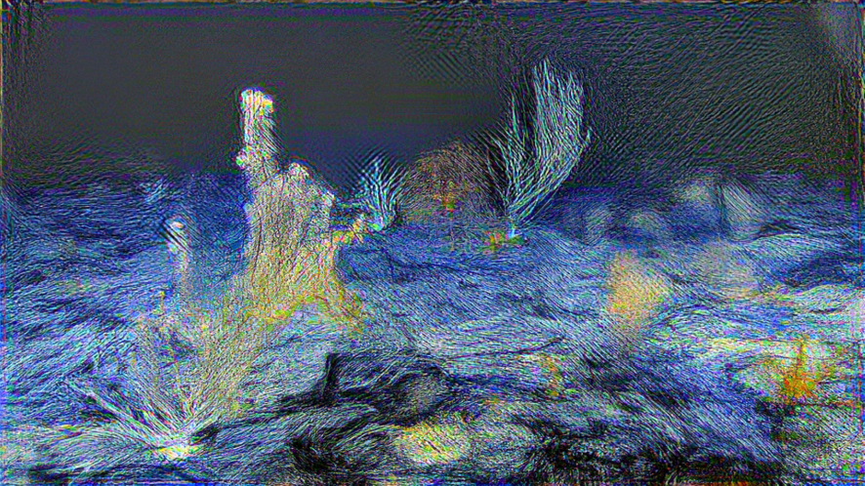
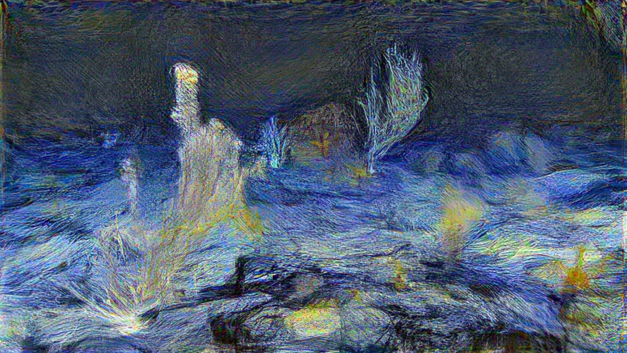
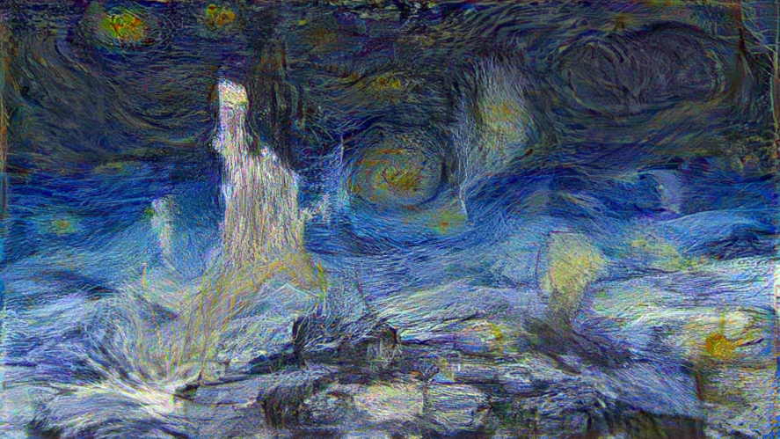
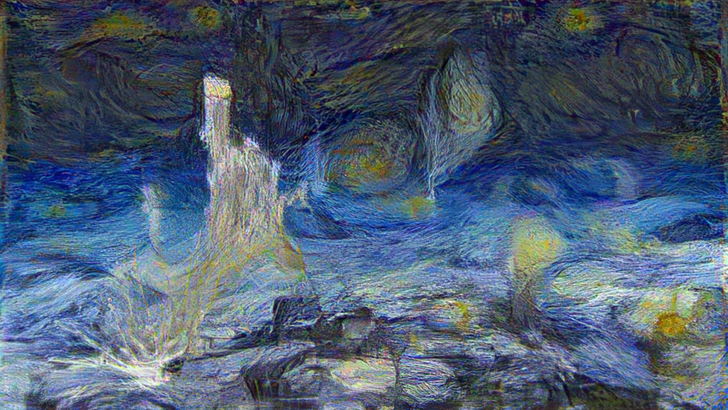
Losses at different layers
Original
Style
Layers from first 2 blocks
Layers from first 3 blocks
Layers from first 4 blocks
Layers from first 5 blocks

Slide 6
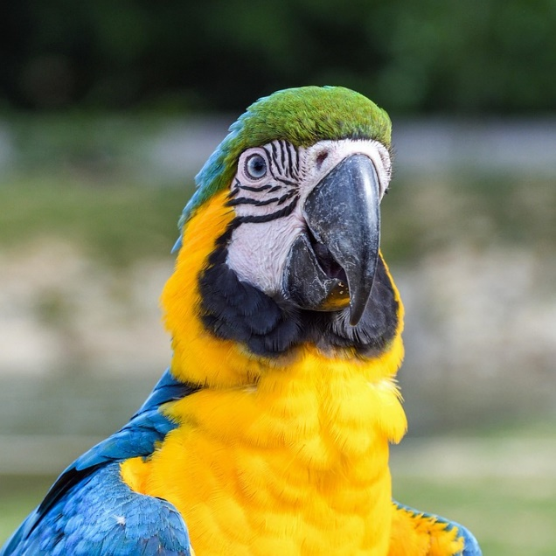
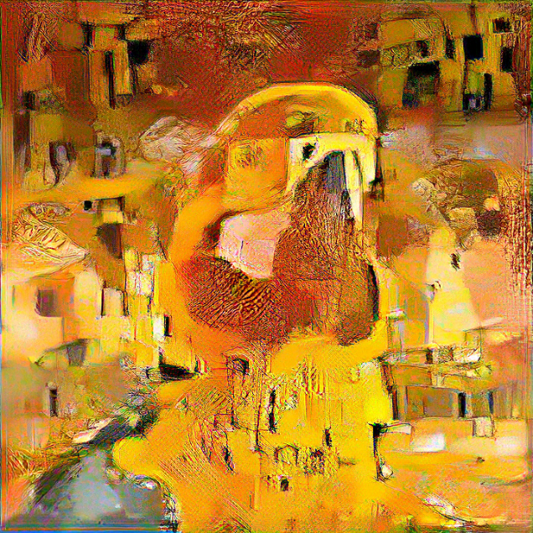
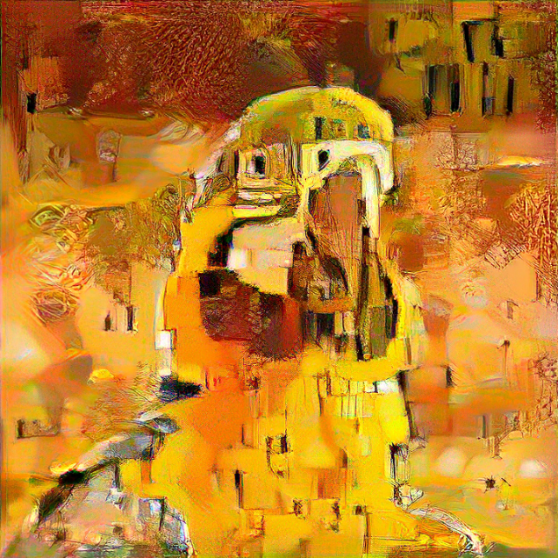
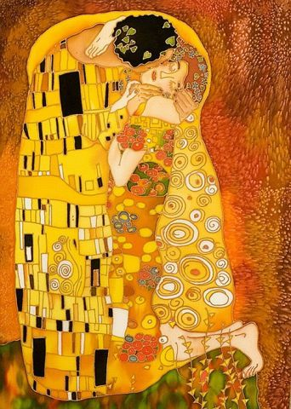
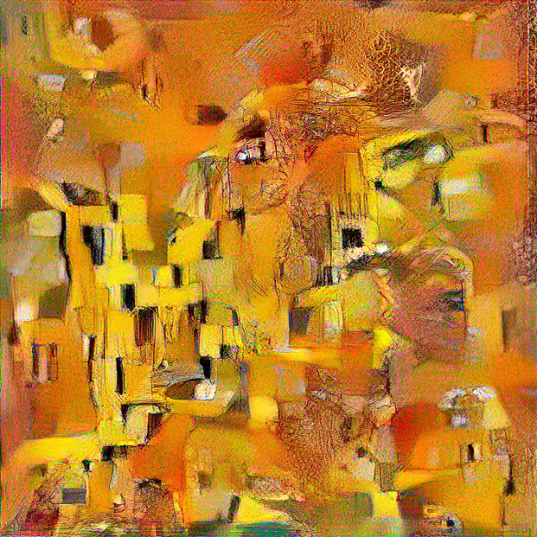
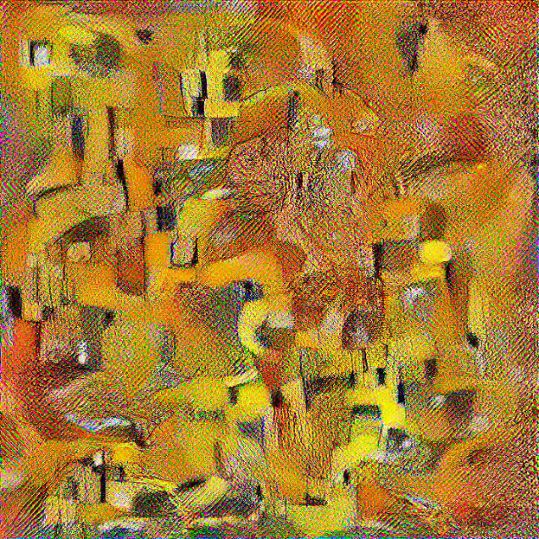
Input image differences
Original
Initialized with original
Initialized with colormapped original
Style
Initialized with noise
Initialized with colormapped noise

Slide 7
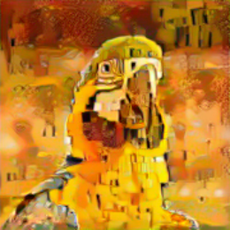


Challenges: low resolution

Slide 8
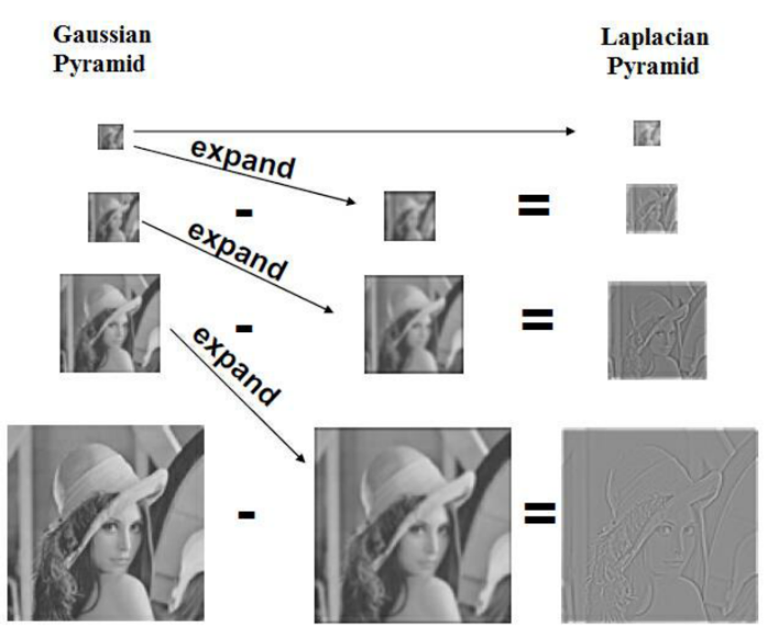
Laplacian pyramid
This picture is
substituted for
stylized image

Slide 9
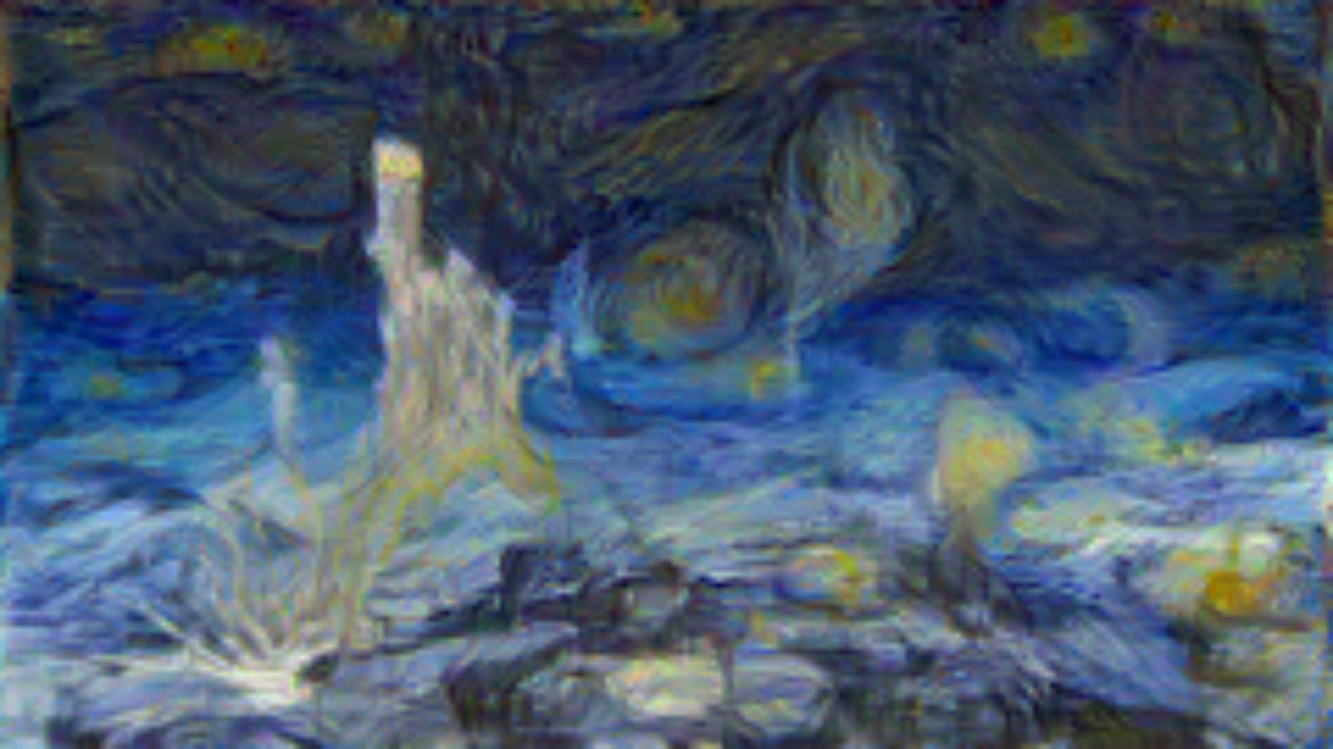
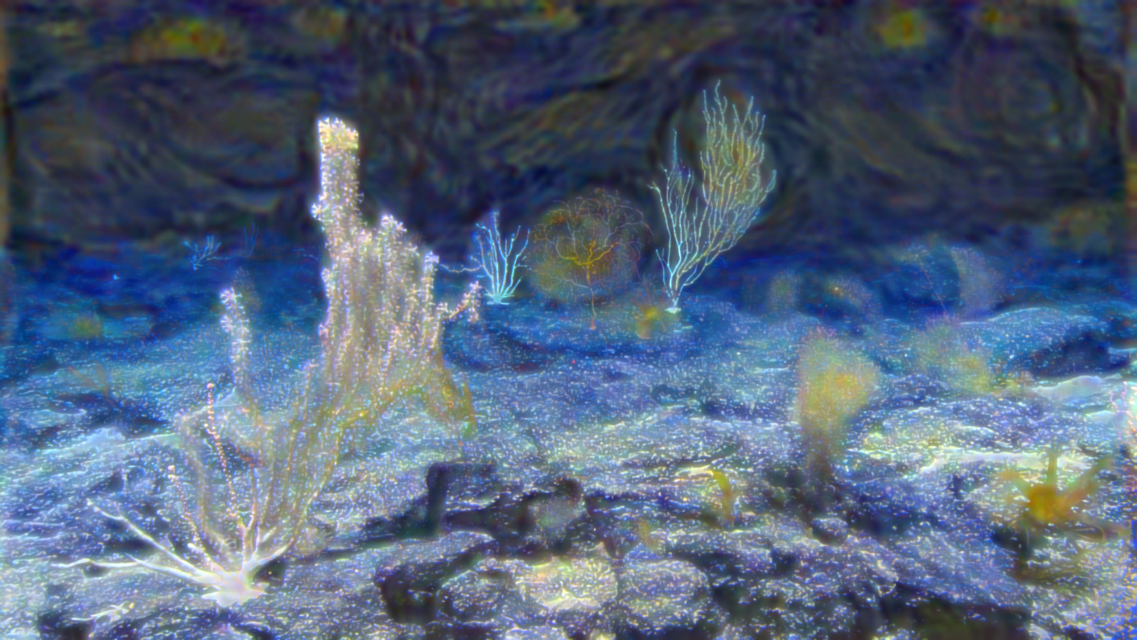
Laplacian pyramid

Slide 10
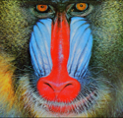

ESRGAN
Resized, 500x480 (x4)
Upscaled with ESRGAN, 500x480 (x4)
Original,
125x120

Slide 11
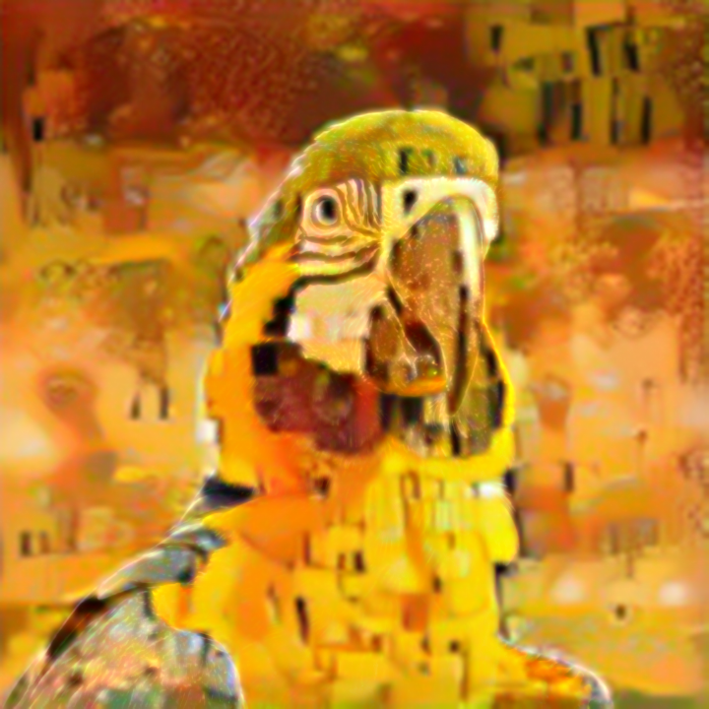

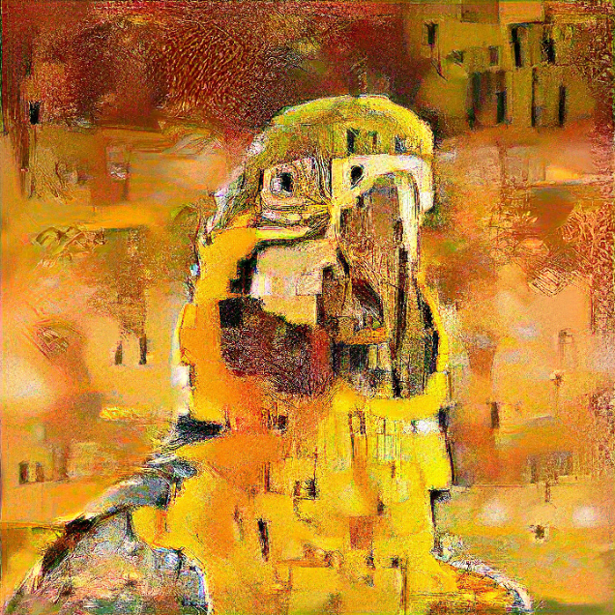
Laplacian pyramid and ESRGAN
Original
Laplacian only
Laplacian fist, then ESRGAN
Resized
ESRGAN fist, then Laplacian
ESRGAN only

Slide 12
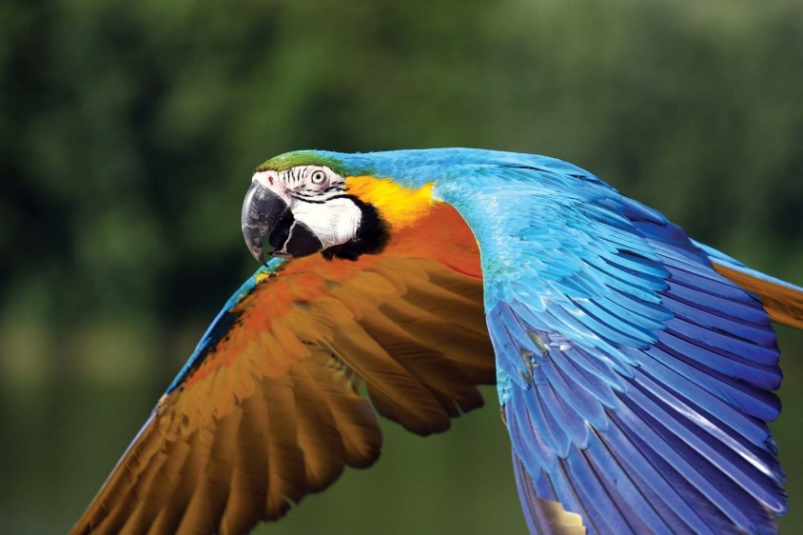
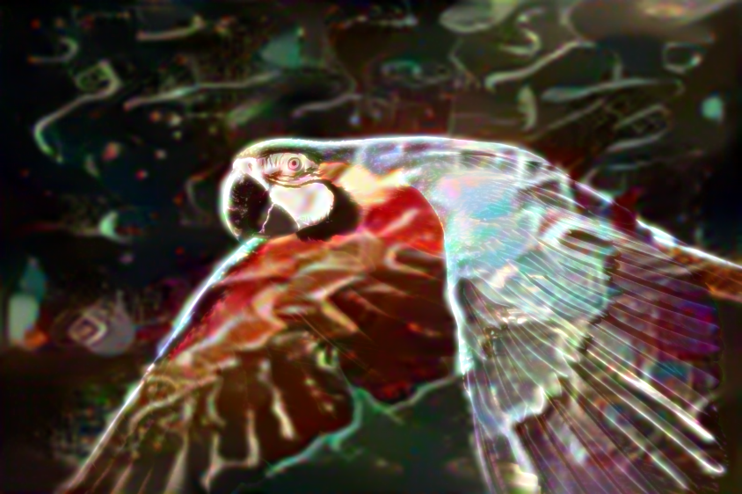
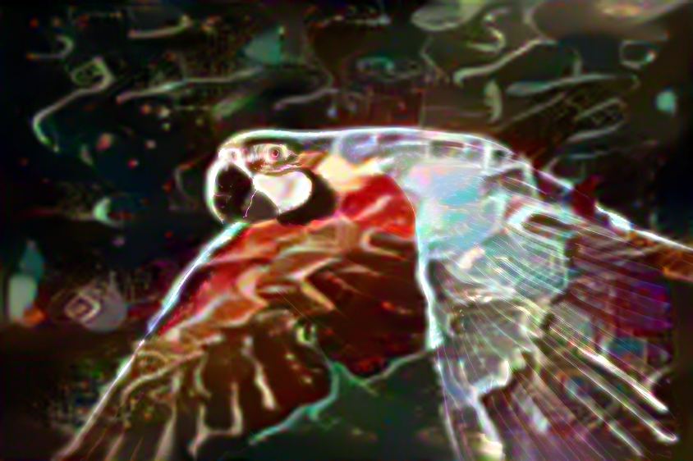
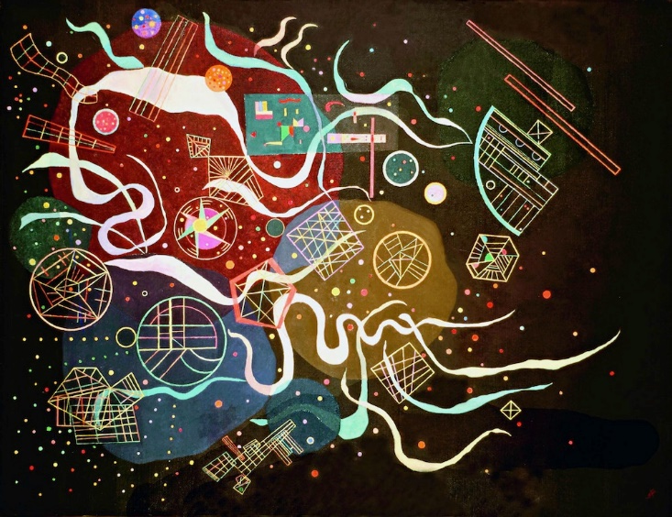
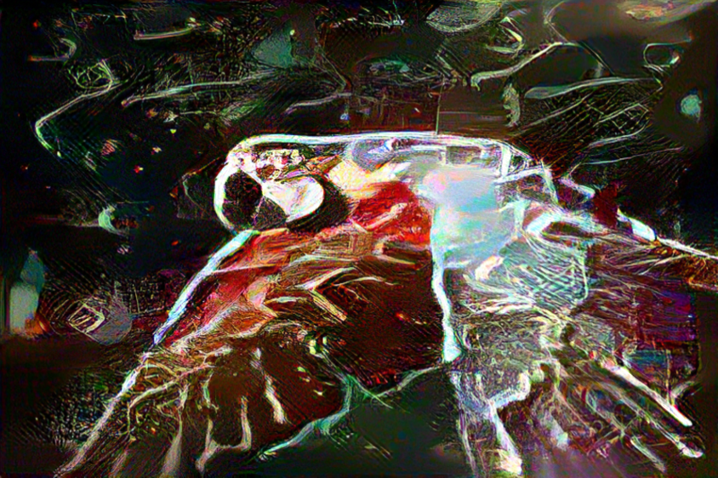
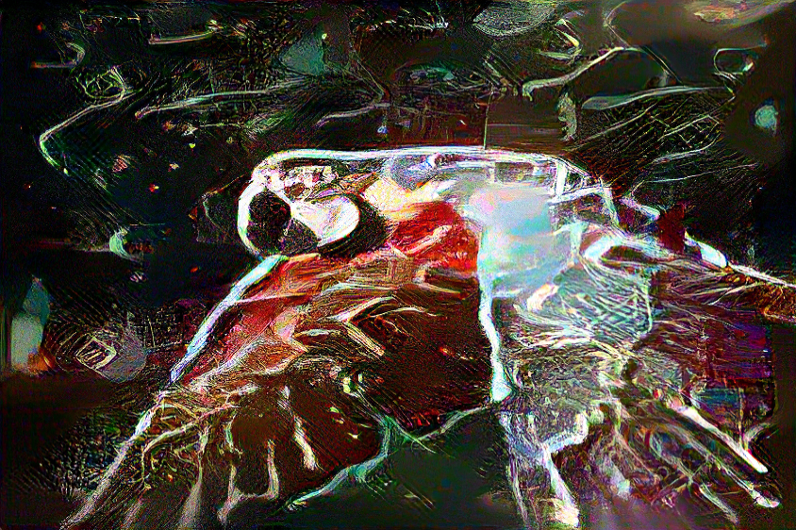
Laplacian pyramid and ESRGAN
Original
Laplacian only
Laplacian fist, then ESRGAN
Style
ESRGAN fist, then Laplacian
ESRGAN only

Slide 13
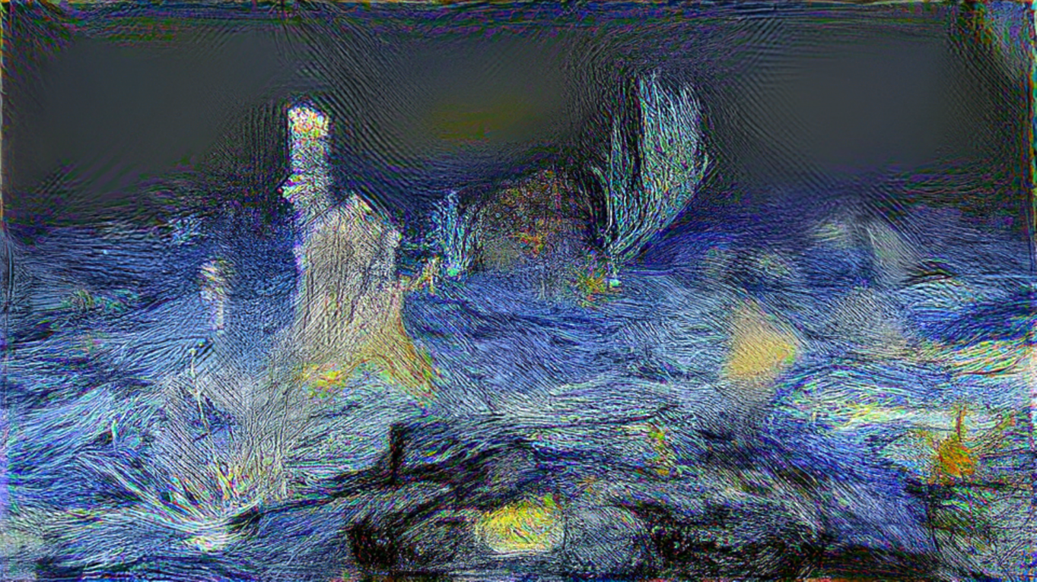


Challenges: color noise

Slide 14
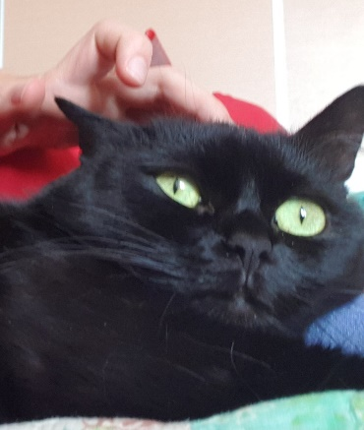


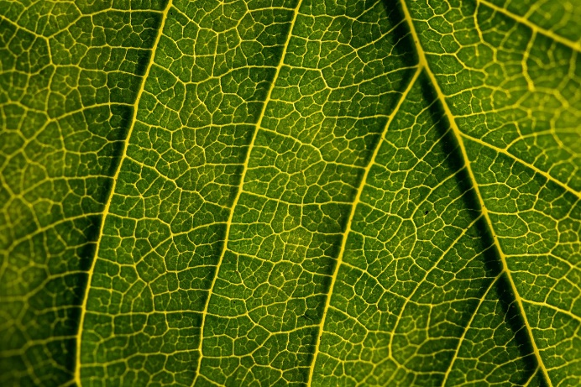
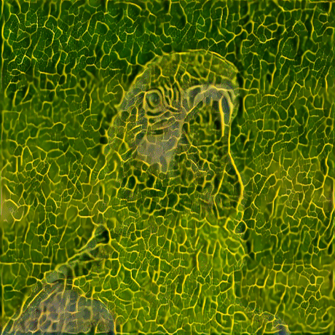
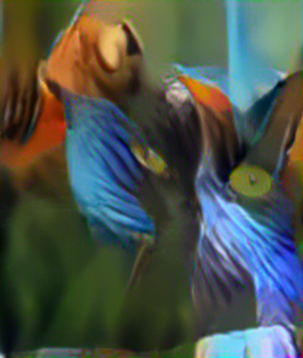
Unsolved challenges
No metrics, only visual evaluation of quality is possible
Not every style image yields good results
Therefore, it is hard to tell, if the result is underwhelming because of the of the parameters or because of the image
+
=
+
=

Slide 15
Thank you!

